Slide 1

International Students Expense
Final Project
Team:
Vaibhav Chauhdari
Harshit joshi
Amisha

Slide 2
Overview
International students face multiple challenges when they come to a different country for studies. It is tough to manage expenses sue to several factors like currency change, new food habits, home rents, and more.
We want to develop a database where data about expenses, habits, priorities and details of international students.
This will help us to develop a database that can be used to understand the international student community at Syracuse University and provide key analysis that could be used to provide recommendations to the university so that they can help the community.
To accomplish this goal we worked on various steps like Planning the database design, E-R requirements, Conceptual Model, Logical Model, Data Logics, SQL Implementation, User Application on MS PowerApps.
The database has 16 tables and 4 data logics (2 stored procedures, 2 views).

Slide 3
Planning
We want to capture, basic details of the international students like contact, academics, address, employment.
A table with details related to expenses for food, shelter, transport and more.
Priorities where students want to spend and save.
Particular choices for basic living like which supermart they buy groceries from, where do they prefer to eat on campus, which mode of transport do they prefer.
An application will be developed to enable the user to take this survey in an organized way and submit their responses.

Slide 4
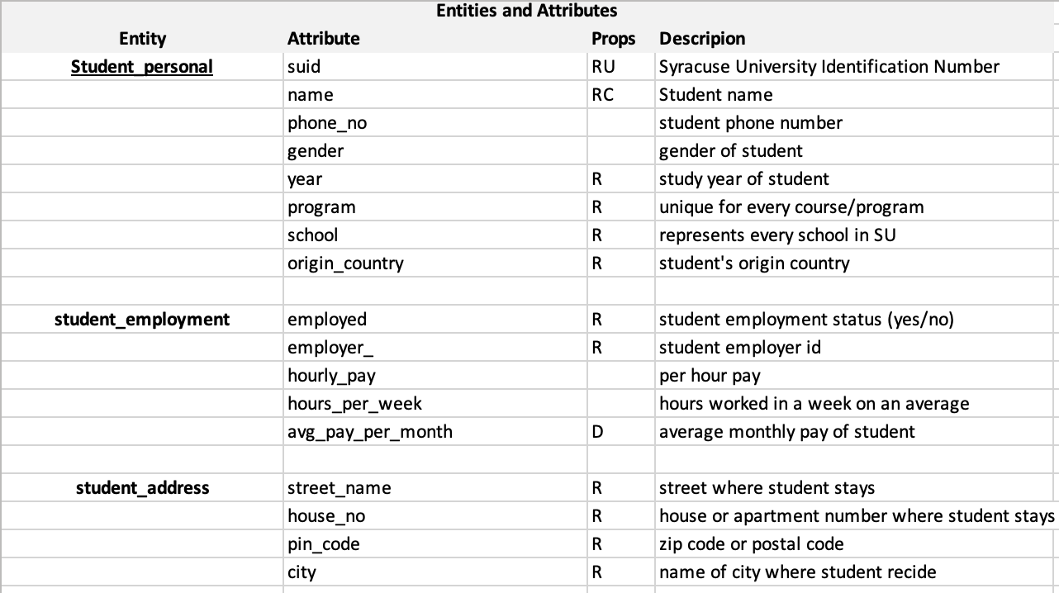
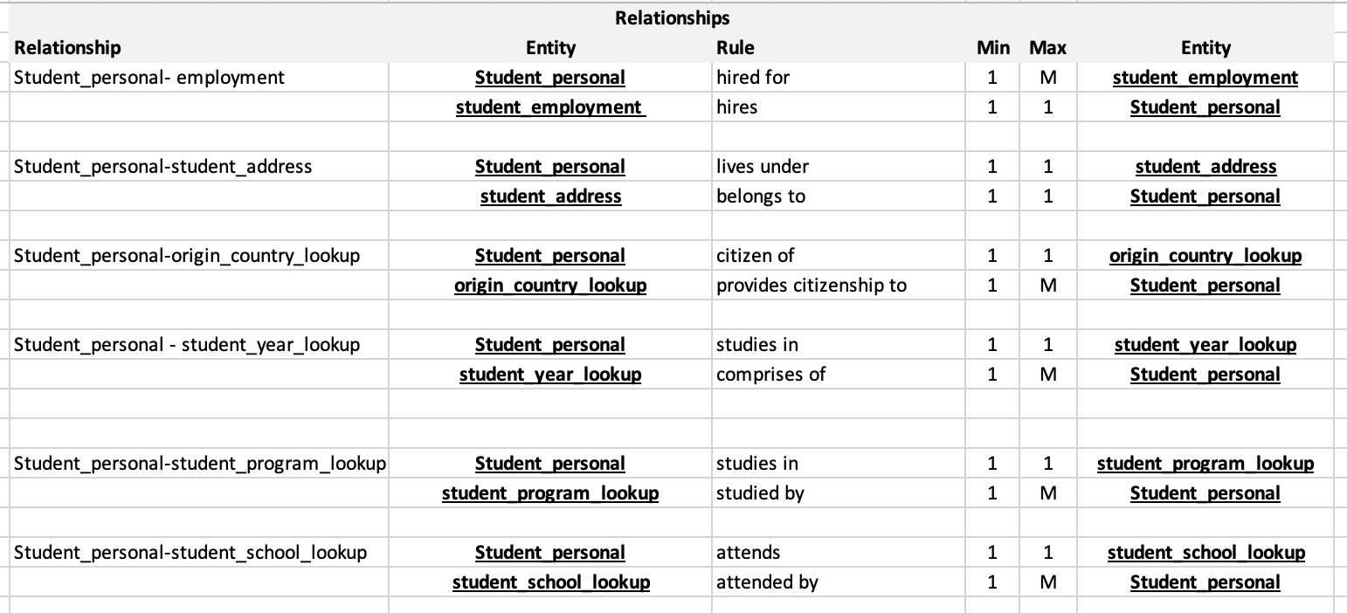
E-R Requirements
According to our E-R requirements we have 6 main tables names student_personal, student_address, student_employment, monthly_expense_wallet, food, and transport.
There are lookup tables as well such as year_lookup, school_lookup, origin_country_lookup, employer_lookup and more.
We were able to define the properties of table entities, relationships between the tables, entity relationships, and business rule for relation.
A glimpse of our E-R requirement

Slide 5
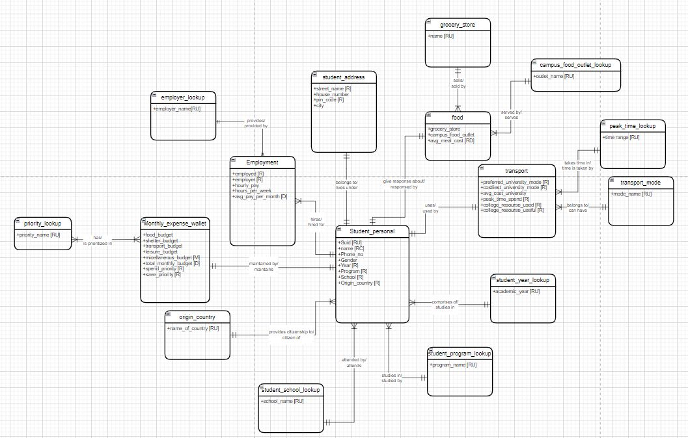
Conceptual Model

Slide 6
Conceptual Model
Created relationships between tables based on their respective attributes.
Defined cardinalities for tables like:
1-M
1-1
Defined business rules for the cardinalities between tables.
Cardinalities defined by crow foot notations.

Slide 7
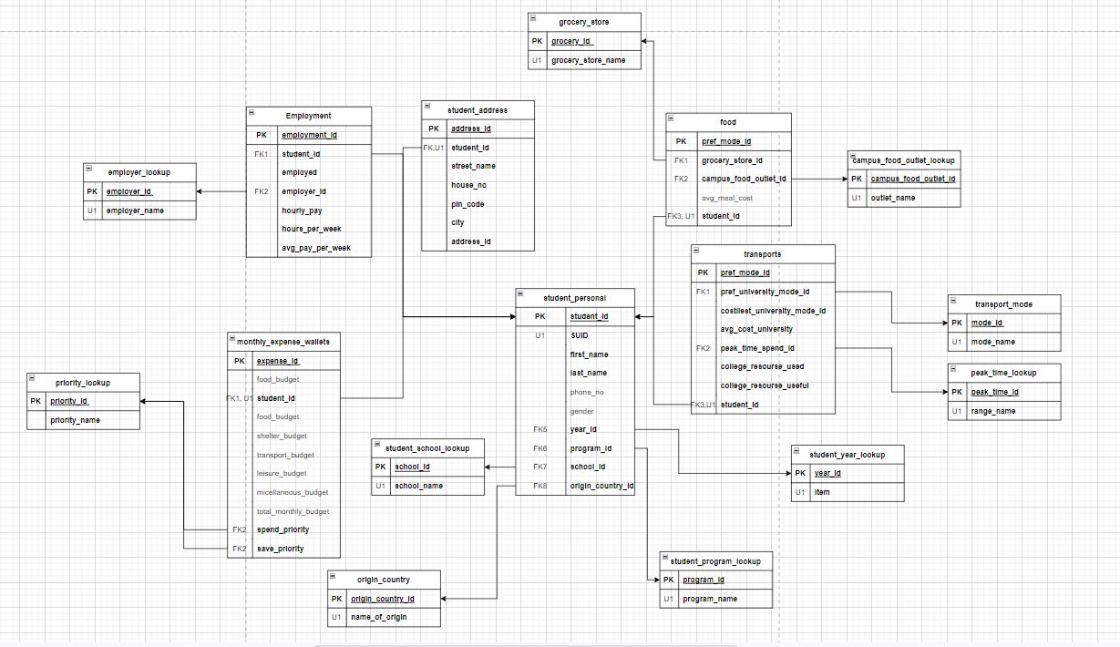
Logical Model

Slide 8
Logical Model
We defined the properties of table attributes such as unique, primary key, foreign key and derived.
Proper cardinality flows defined for tables to show relationships between different tables.
Surrogate keys or table primary keys are added in the logical model.

Slide 9
Design and Implementation
Used Azure Data Studio to create the database. The database name is student_expense_survey.
In our SQL Up/Down script, we created the lookup tables first followed by the 6 main tables.
Constraints for the table were declared directly in the create statements.
Followed proper logic of dropping constraints and tables then creating them in the SQL script.
Lookup tables populated with the data required by insert statements.
Inserted initial data into all the tables with the insert part of the script.
Deployed 4 data logics in the script 2 stored procedures and 2 views.
Constraints for foreign keys, primary keys, unique, check were added to the tables as per requirement.

Slide 10
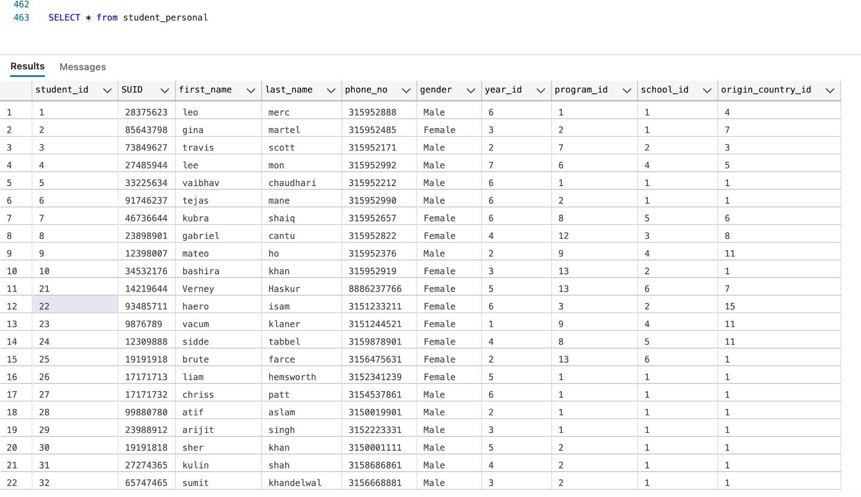
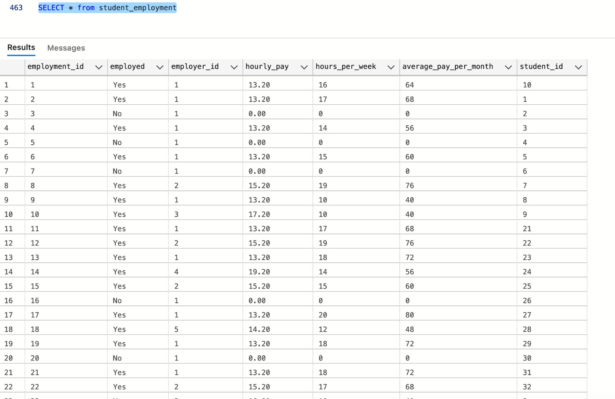
Tables

Slide 11
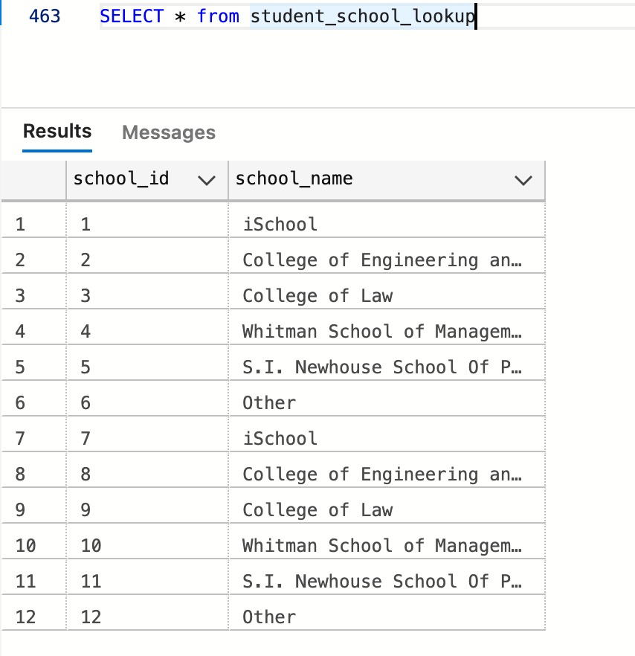
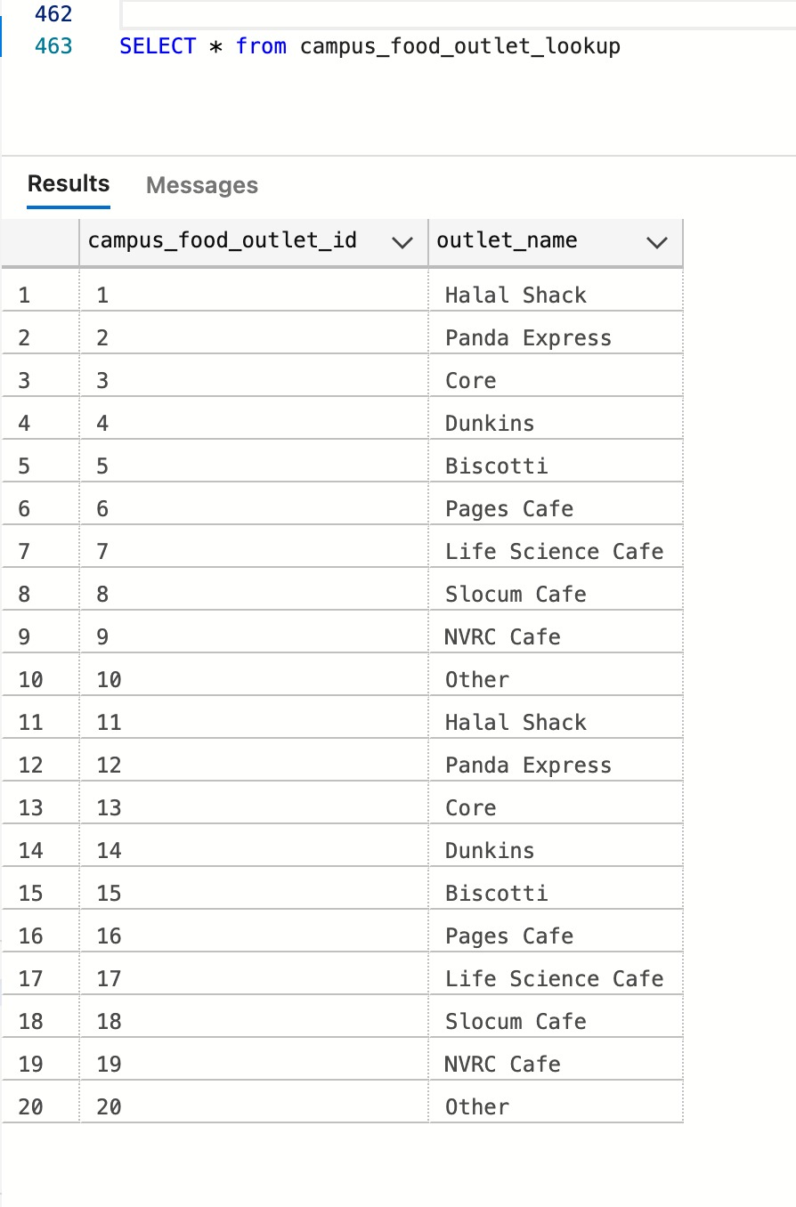
Lookup Tables

Slide 12
Data Logics
Update Employment Details: A student wants to change his/her employment status. We wrote a stored procedure to accomplish this where the check item for us is the student_id. If the student id exists, then we set the employment table attributes to the read in values of variables declared in stored procedure else just insert the data as a new row.
Update Address : A student can update his/her address if they relocate. We wrote a stored procedure to accomplish this where the check item for us is the student_id. If the student id exists, then we set the address table attributes to the read in values of variables declared in stored procedure else just insert the data as a new row.
Student top choice: A student would like to know what are the common choices of the student community for shopping, eating and which is common employer for most of them. For this we created a view.
Participating countries: A student can look at what countries are represented in the surveys taken. For this we created a view.

Slide 13
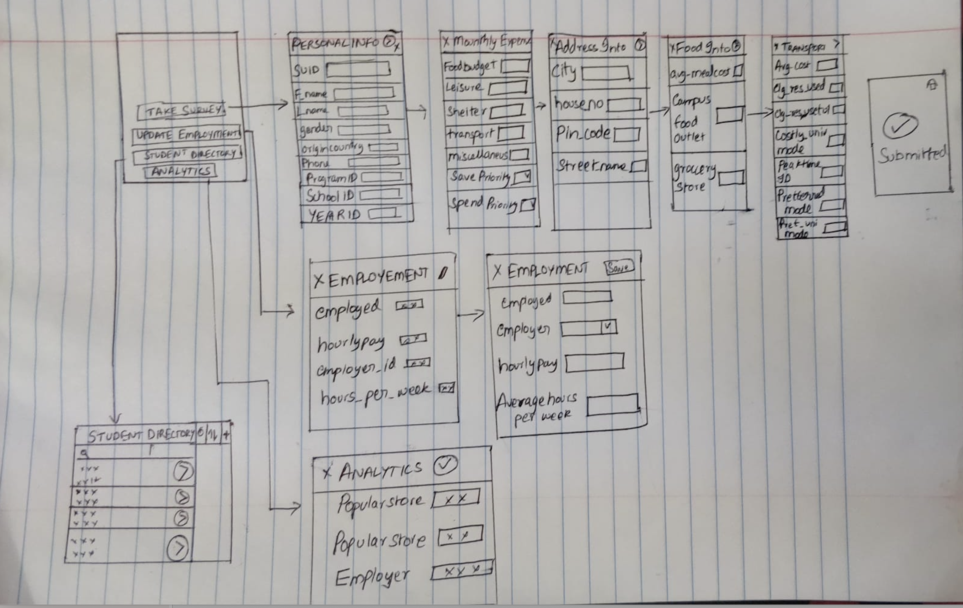
Application Design
We have tried to consider 4 user cases:
To take new entry or data from the user
To update the employment details
Show some analytics
View the data

Slide 14
Application Implementation
HOMEPAGE: Gives user the four options - Enter the new data (Take Survey), to modify the Employment Info(Update Employment), View the whole dataset (Student Directory) and to view the populars (Analytics).
TAKE SURVEY: Lets the user to enter the personal info, address, employment details, preferences in expenses , food and transportation favorites. On backend it updates the new entries to student_personal, student_employment, student_address, monthly_expense_wallet, food, and transport.
STUDENT DIRECTORY- Let’s the user to view the details of all the entered directories. It displays the whole student_personal table.
UPDATE EMPLOYMENT- If user wants to view/ edit his employment details. It displays the student_personal to select for which student you want to view/edit the student_employment table.
ANALYTICS- Helps to view the popular store, food outlets and employer among students. Using view function we are running analysis on frequently preferred stores, food outlets and employers.

Slide 15
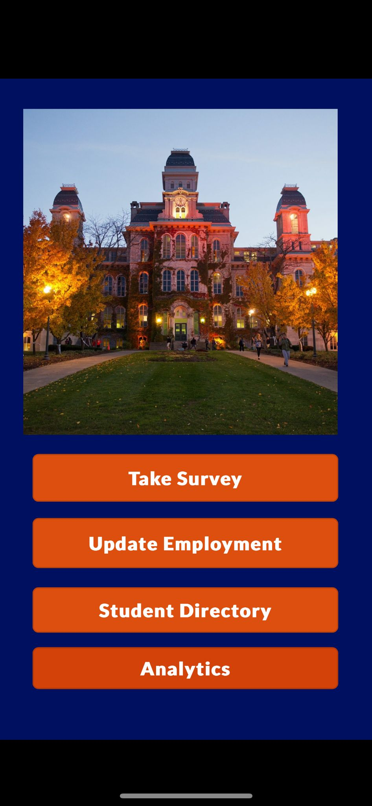
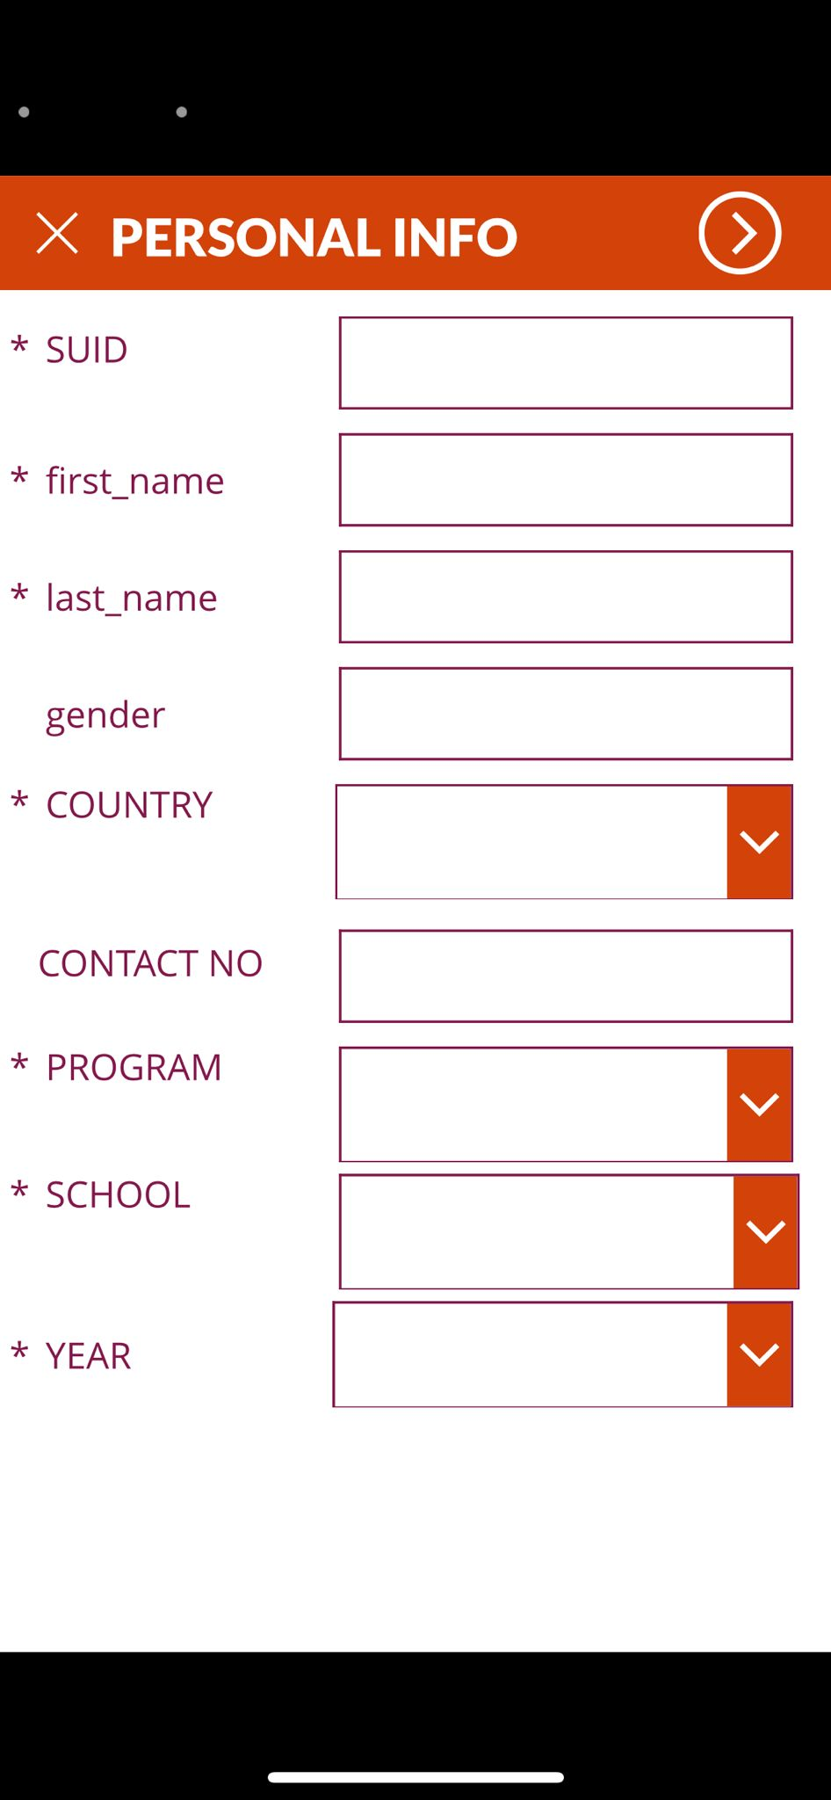
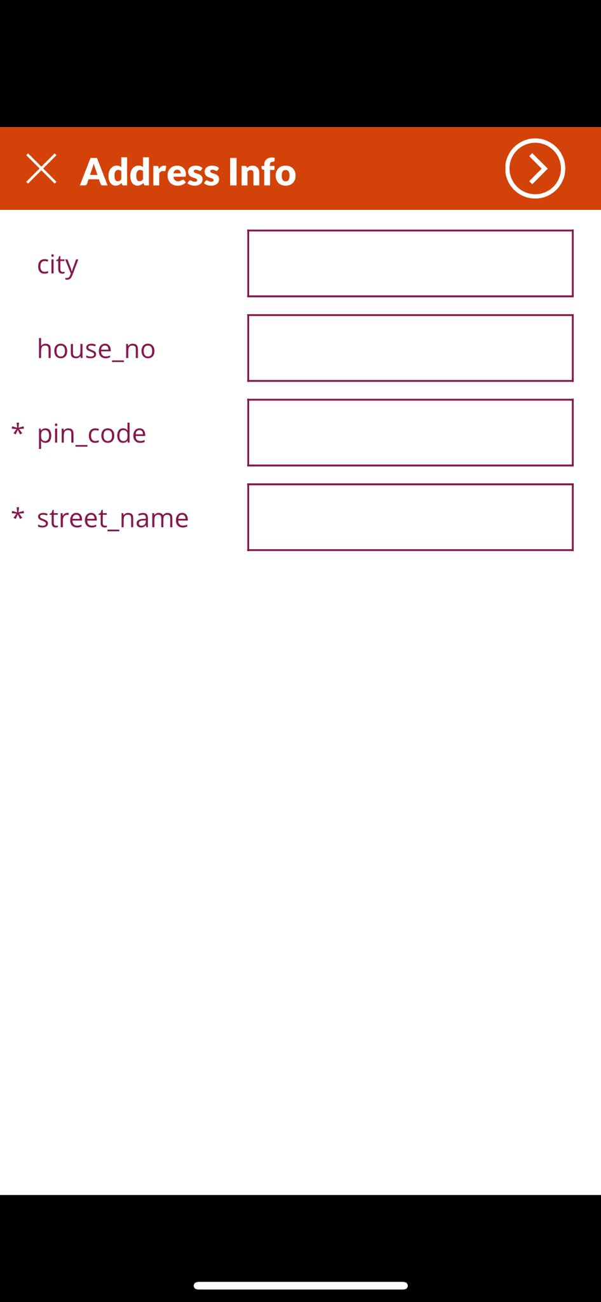
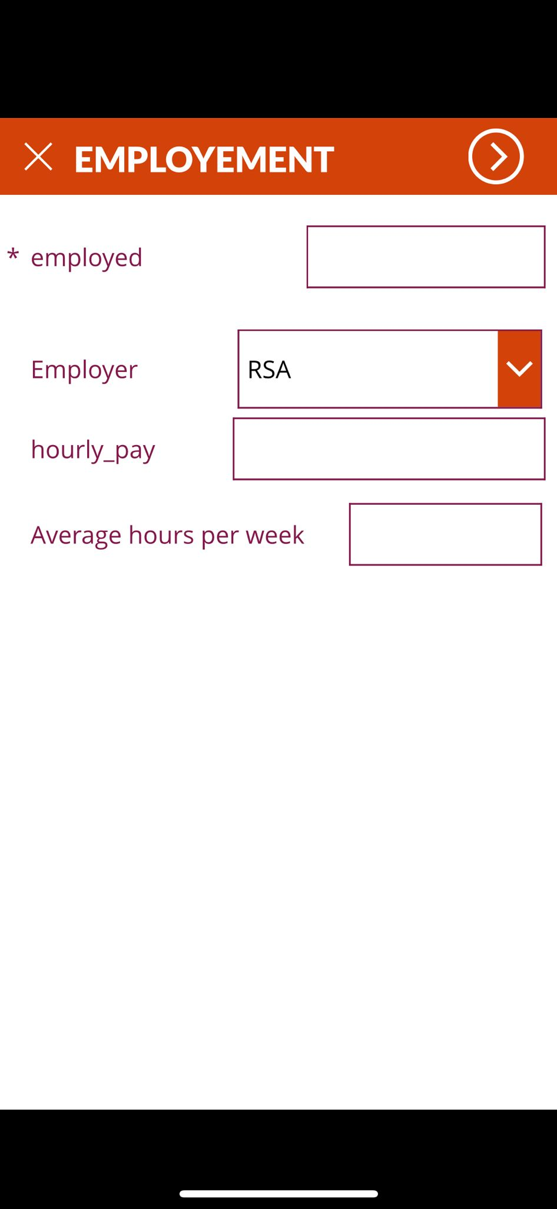
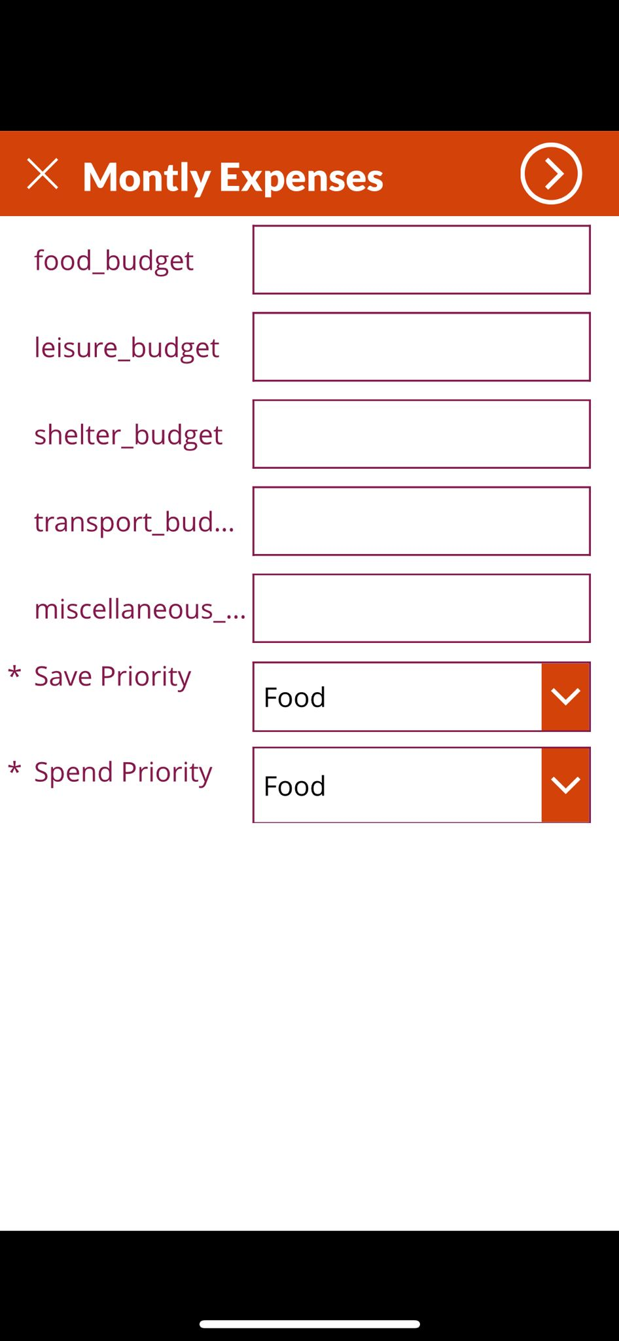
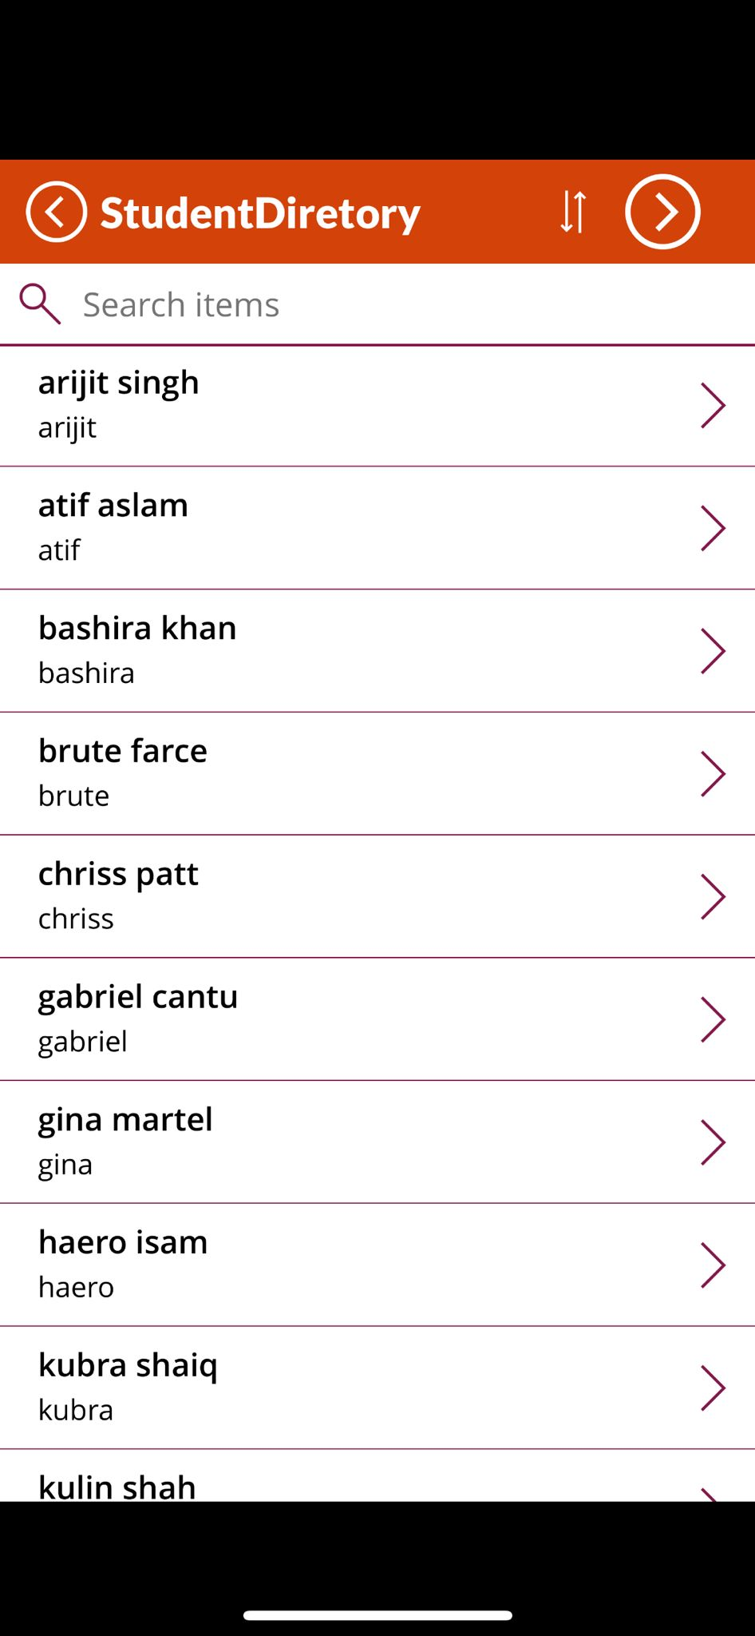
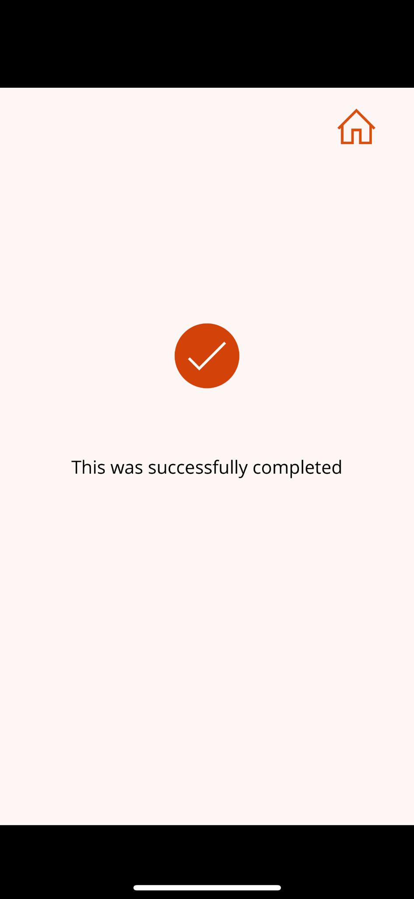
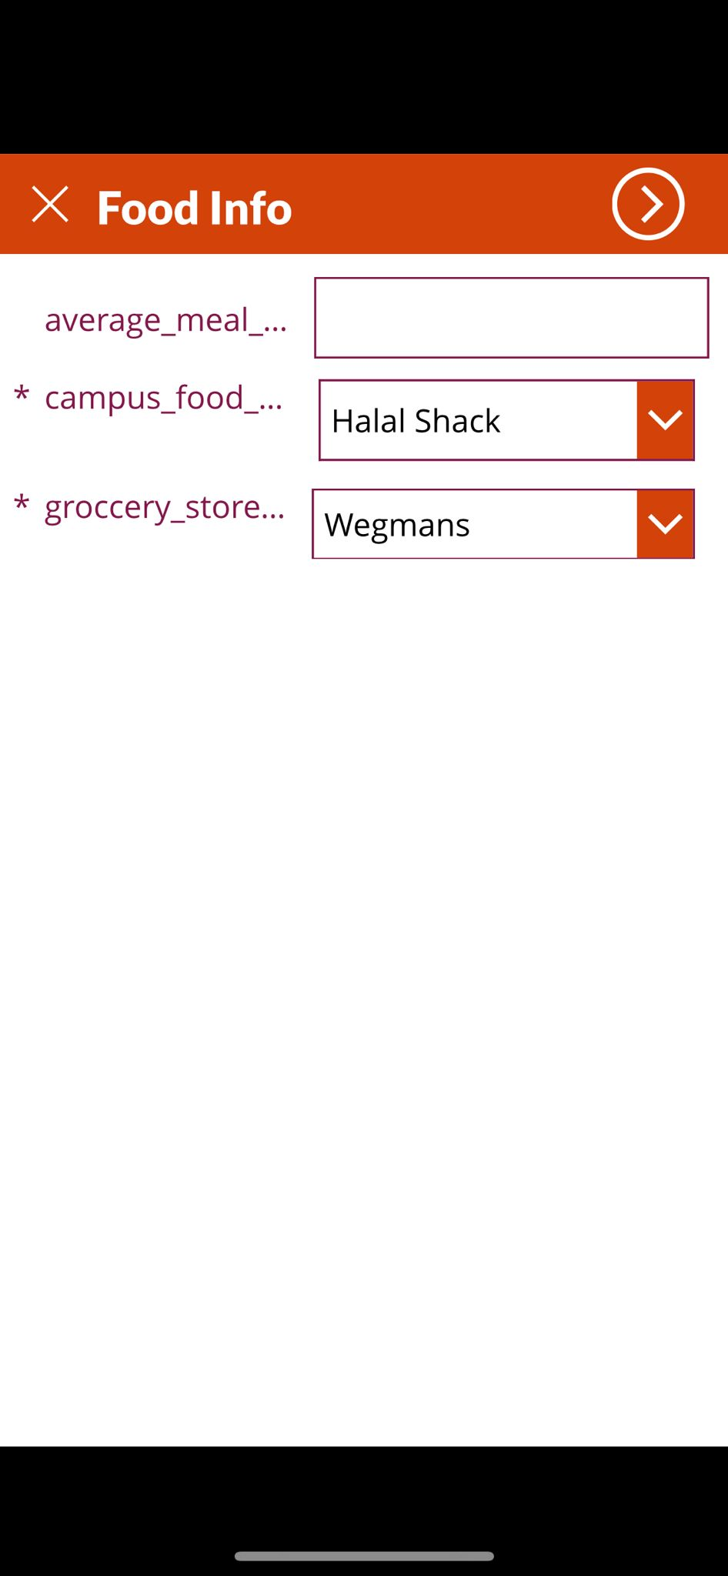
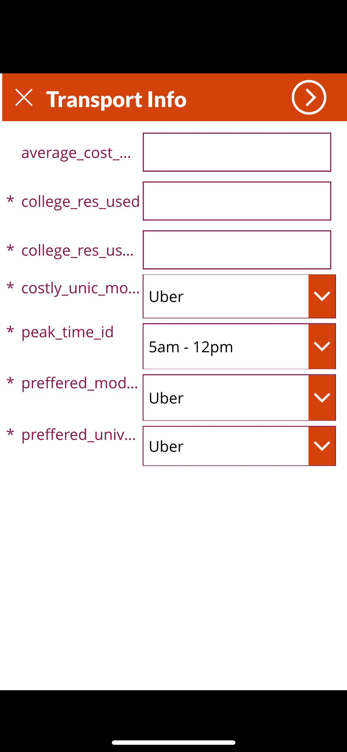
Working of Application
New User Taking Survey

Slide 16
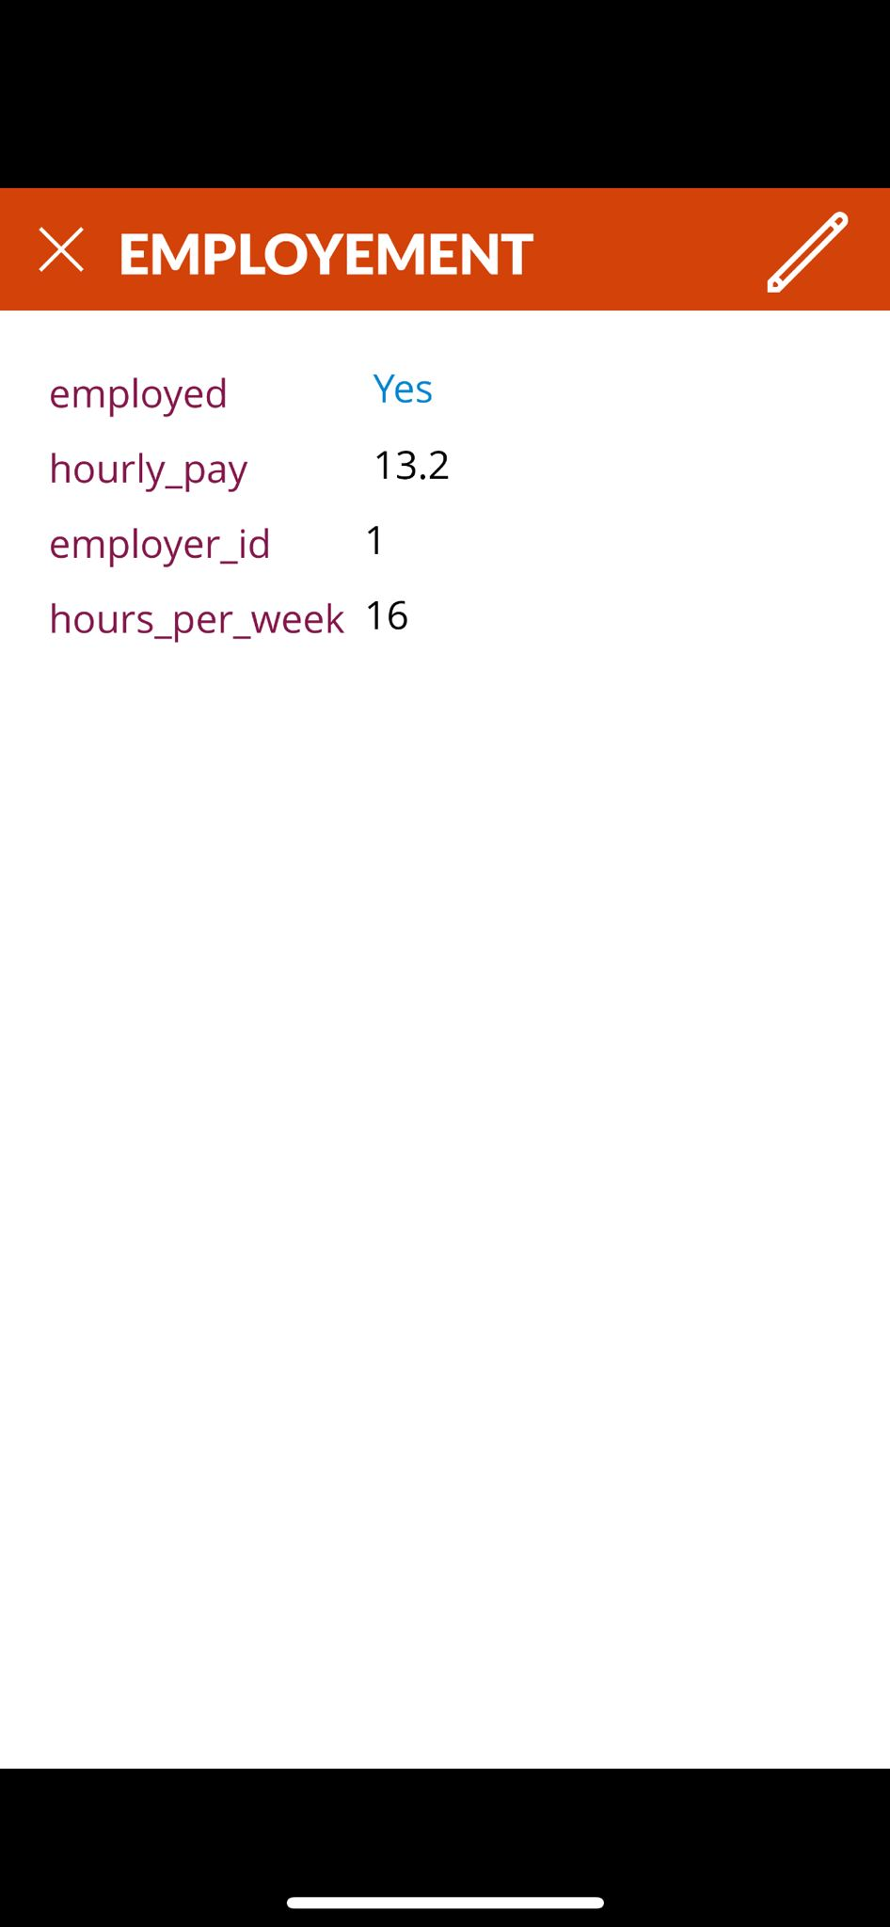
Student Updating Employment
Status

Slide 17
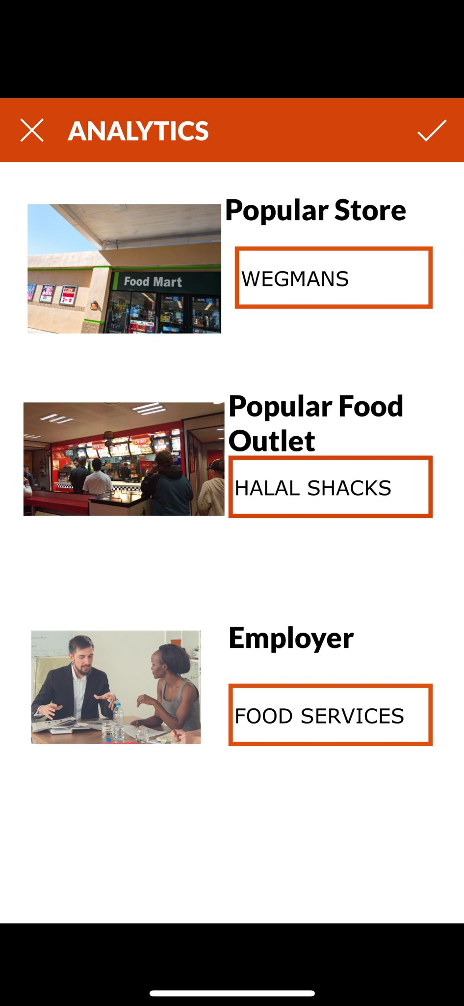
Student can see other students
choices for stores and food outlets and
most common employer

Slide 18
THANK YOU !

